Slide 1
Emergency Management System
Sridharsan V
(22pt33)

Slide 2
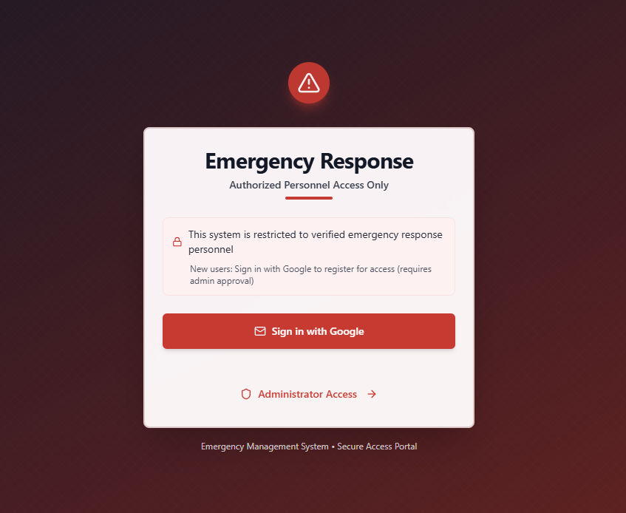
Login Page :-

Slide 3
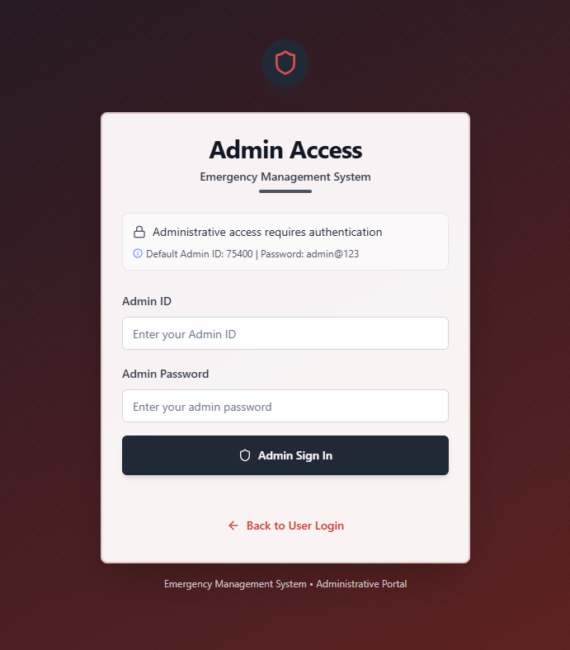
Admin Login page:-

Slide 4
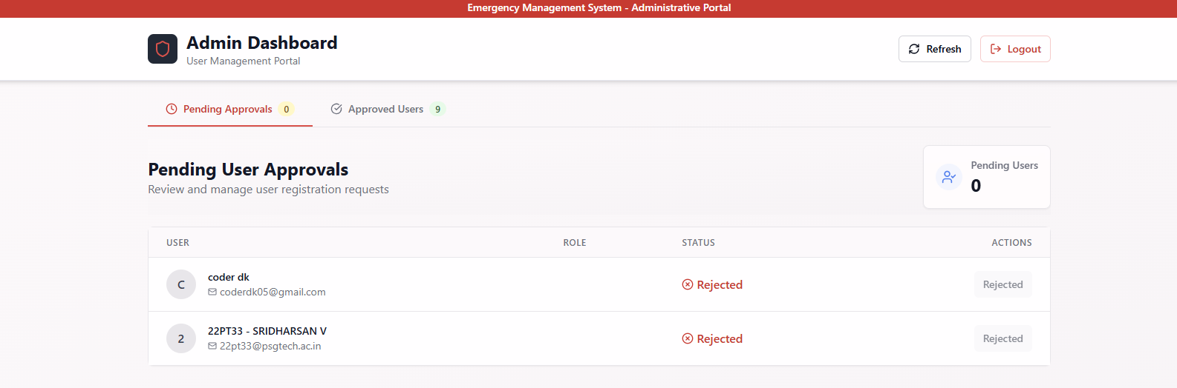
Admin dashboard:-

Slide 5
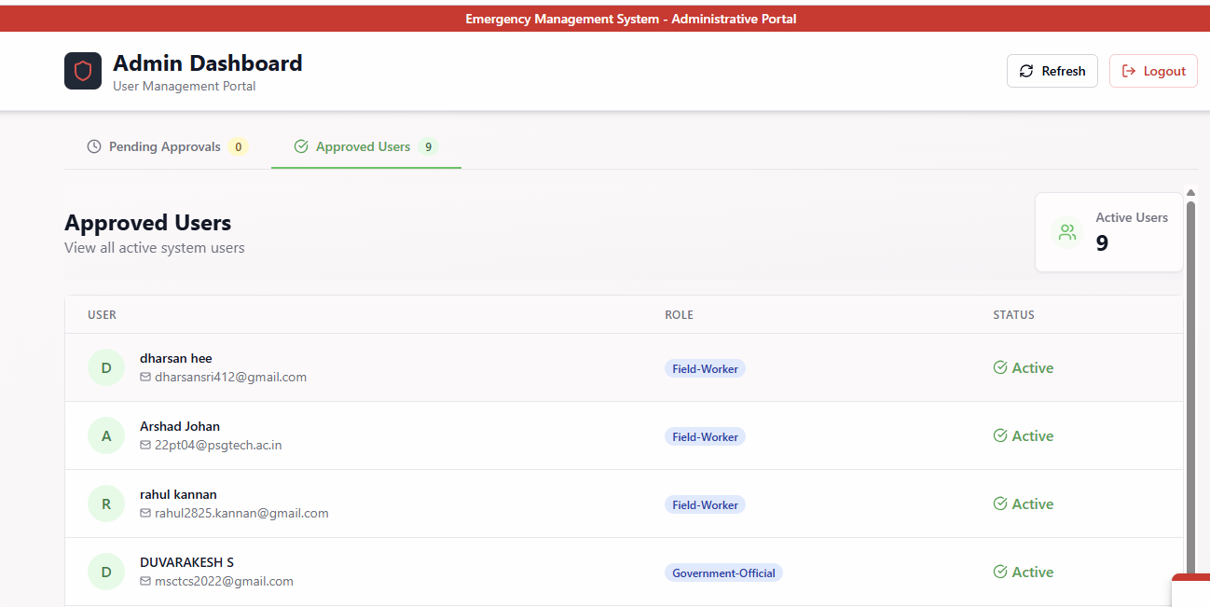
Admin dashboard:-

Slide 6
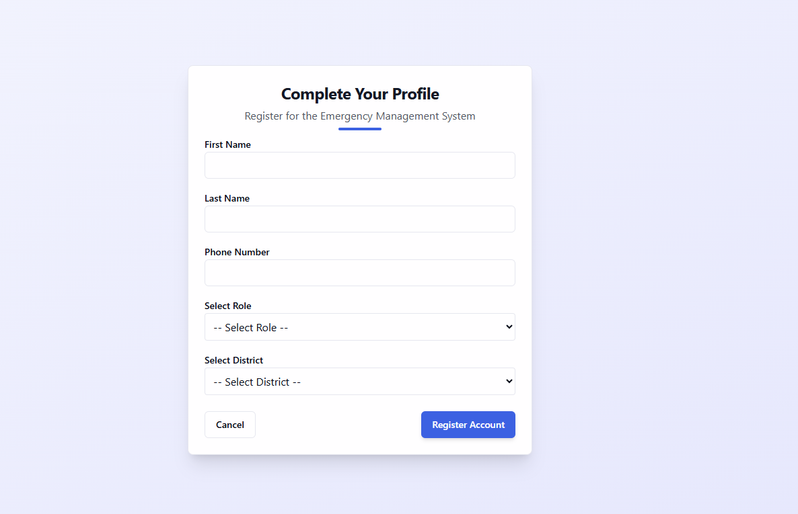
New user registration:-

Slide 7
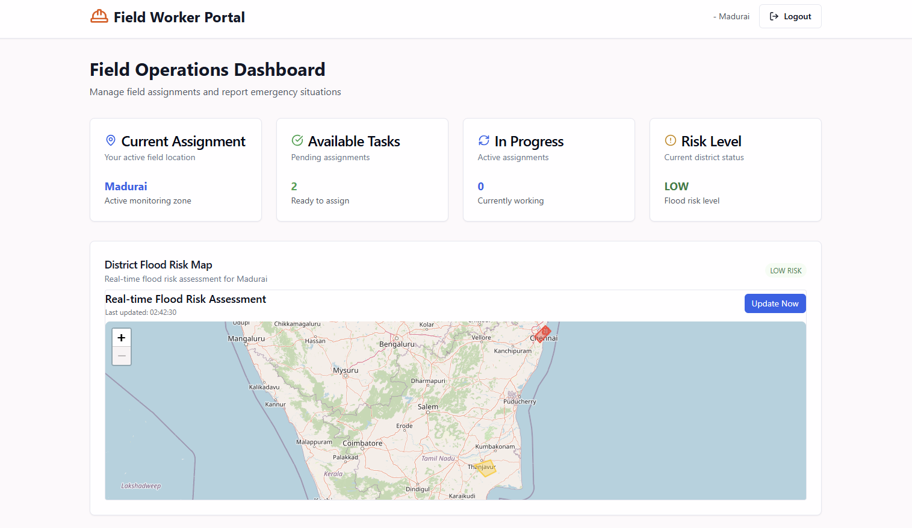
Field Worker Dashboard:-

Slide 8
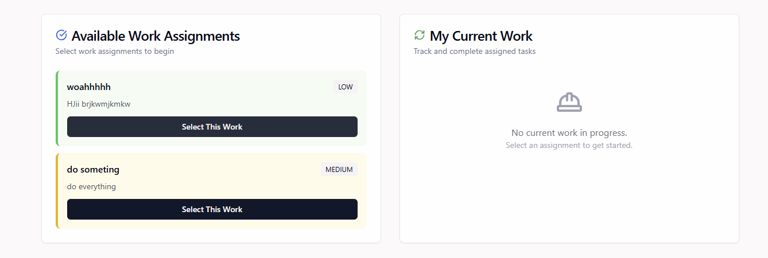
Field Worker Dashboard:-

Slide 9
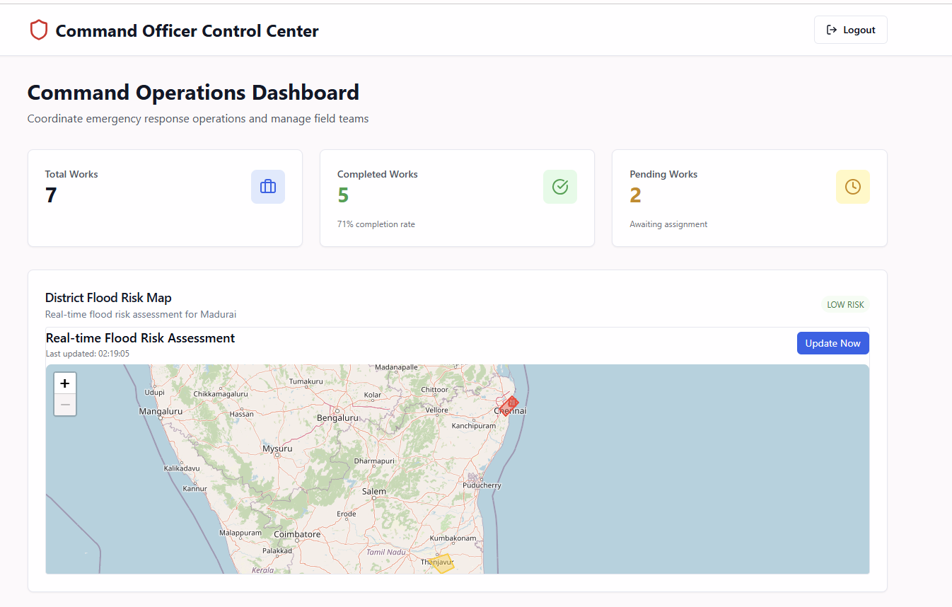
Command Officer Dashboard:-

Slide 10
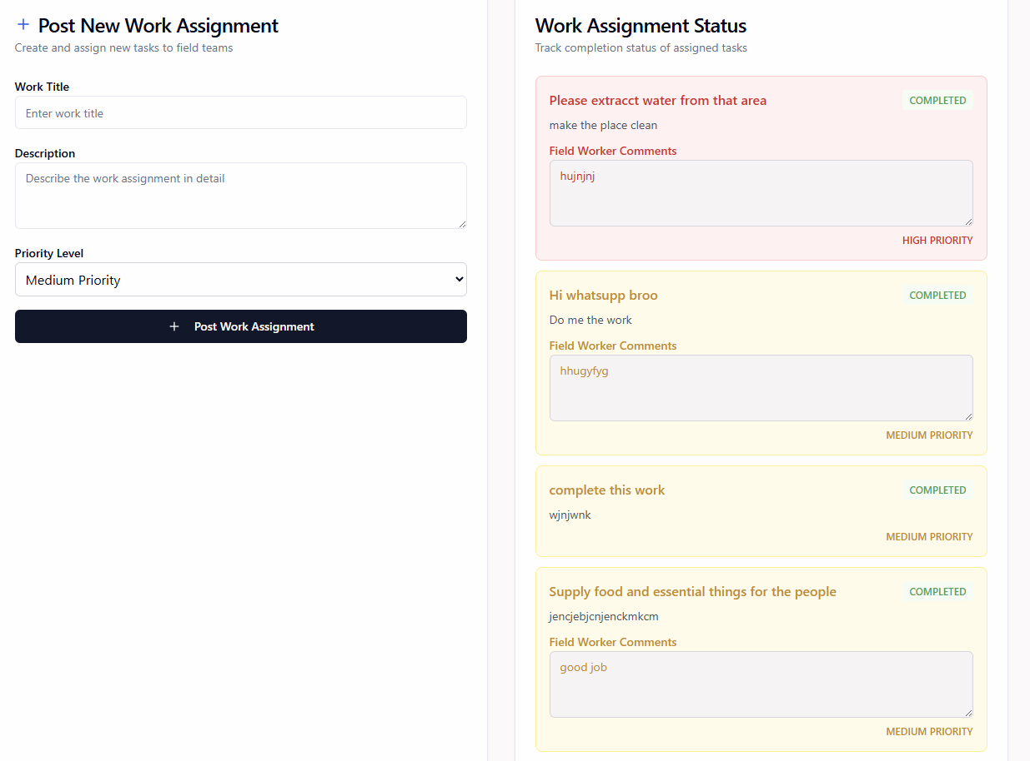
Command Officer Dashboard:-

Slide 11
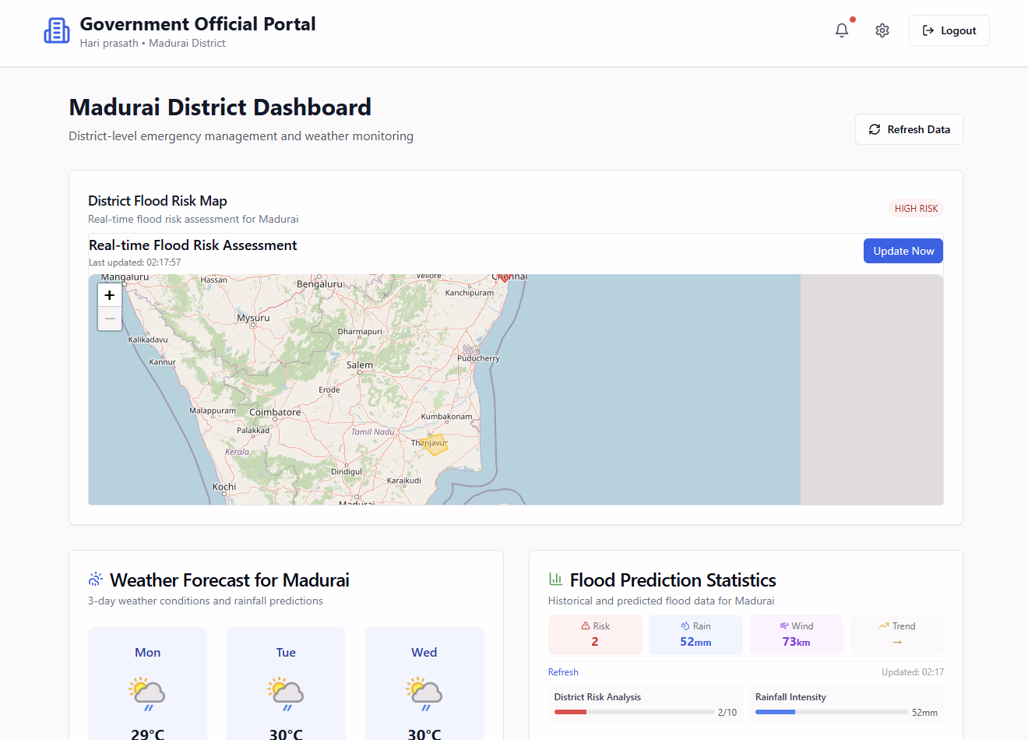
Government Official Dashboard:-

Slide 12
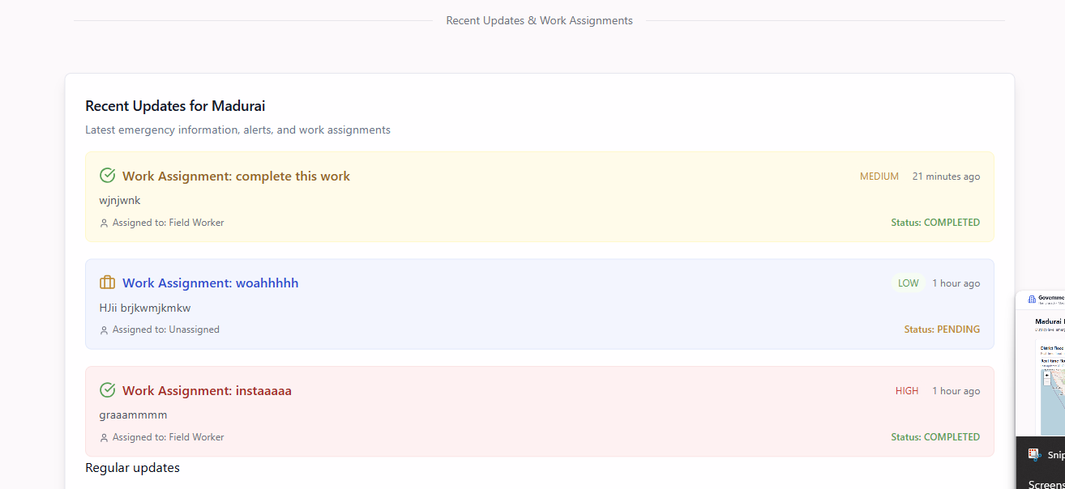
Government Official Dashboard:-

Slide 13
Prompts towards my approach towards the problem:-
You are an expert flood risk analyst with deep knowledge in hydrology, soil types, land use, drainage infrastructure, and historical flood data.
Given the past 3 days of weather data for [District Name] (including temperature, humidity, wind, and rainfall), and using your knowledge of environmental conditions, generate a GeoJSON output marking flood-prone areas with risk levels:
High
Moderate
Low
Each GeoJSON feature must include:
District name
Risk level
Short reasoning (e.g., "low permeability soil + high rainfall")

